Slide 1

Digital Image Processing, 3rd ed.
Chapter 6
Color Image Processing
Dept. Computer Science & Engineering
Hongtao Lu
10/11/2017

Slide 2
Outline
Full-Color Image Processing
Color is acquired with a full-color sensor
Pseudo-Color Image Processing
Assigning colors to monochrome images

Slide 3
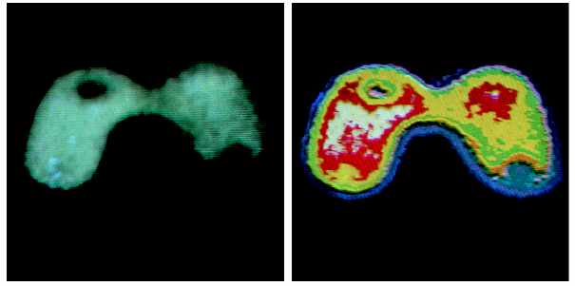
Outline (Cont.)
Color Importance
Color is an excellent descriptor: Suitable for object Identification and Extraction.
Discrimination: Humans can distinguish thousands of color shades and intensities but few shades of gray levels.

Slide 4
6.1 Color Fundamentals
Color and Light
Light is fundamental of color vision
Achromatic light (BW Television): Intensity!
Chromatic light (Color TV): Radiance, luminance, and Brightness
Light is an Electromagnetic waves
The wave which wavelength (pure) is between ~400nm and ~700nm is detectable by human eye and called a monochromatic (not gray level!) light (单色光).
λ < 400nm: Ultraviolet
λ > 700nm: Infrared

Slide 5
6.1 Color Fundamentals
What is Color?
An attribute of objects
Color depends on:
Spectral characterizations of light source (sun!) which illuminates the objects, PSD (Power Spectral Density)
Spectral characteristics of objects (Reflectance)
Spectral characteristics of sensors of imaging systems (ex. Eye)

Slide 6
6.1 Color Fundamentals
Color Fundamentals
Physio-psychological phenomenon
How human brain perceive and interpret color?
Not yet fully understood
Physical phenomenon
Physical nature of color is clear

Slide 7
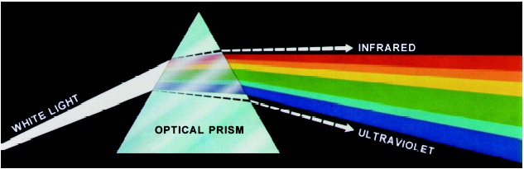
6.1 Color Fundamentals
Newton Experiments (Spectral Analyzer)
Emerging light is not longer white but a continuous spectrum of color from violet to red.
Six broad region: violet, blue, green, yellow, orange, and red.

Slide 8
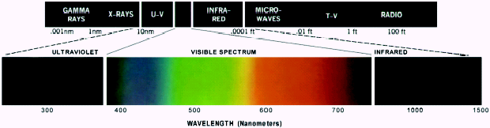
6.1 Color Fundamentals
Chromatic Light
Span the electromagnetic spectrum from 400 to 700 nm
Figure 6.2 Wavelengths comprising the visible range of the electromagnetic spectrum.

Slide 9
6.1 Color Fundamentals
Chromatic Light
Radiance:
Total amount of energy that flows from light source (W)
Luminance:
The amount of energy that an observer perceives from light source. (IR case: R may be high while L is zero)
Brightness:
Subjective description, practically impossible to measure.

Slide 10
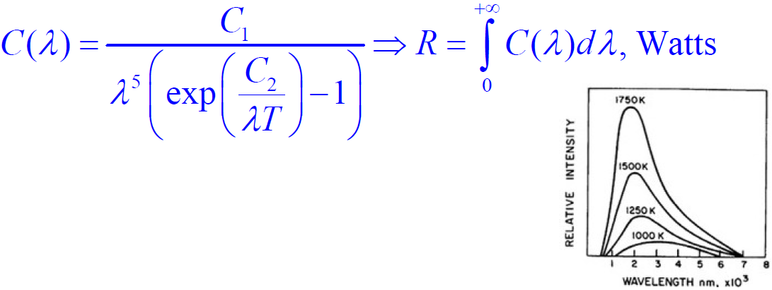
6.1 Color Fundamentals
Radiance for Black-Body radiator (Plank’s law)
For other sources similar curves exist.

Slide 11
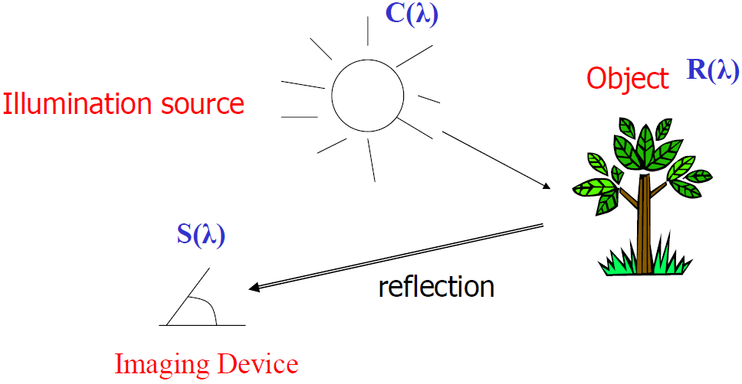
6.1 Color Fundamentals
Luminance of objects

Slide 12
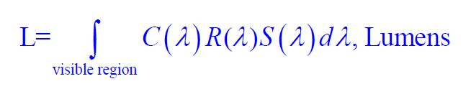
6.1 Color Fundamentals
Luminance of objects

Slide 13
6.1 Color Fundamentals
Brightness of objects
Subject dependent
Human perception of brightness is related to c(λ)
The contribution that c(λ₁) and c(λ₂) make to human perception of brightness are in general quite different for λ₁ ≠ λ₂ even though c(λ₁) may be the same as c(λ₂).

Slide 14
6.1 Color Fundamentals
The relative luminous efficiency of a monochromatic light is defined as c(λ_{r}) / c(λ_{t}) when c(λ_{r}) and c(λ_{t}) are matched in brightness.
c(λ_{r}) is the reference monochromatic light.
λ_{r} is 555 nm (yellow-green light) at which a typical observer has maximum brightness sensitivity.
c(λ_{t}) is a test monochromatic light.
For this reference, the relative luminous efficiency is always less than or equal to 1.

Slide 15
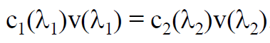
6.1 Color Fundamentals
The relative luminous efficiency as a function of λ is called the relative luminous efficiency function and is denoted by v(λ).
Two monochromatic lights with c₁(λ₁) and c₂(λ₂) appear equally bright to an observer when

Slide 16
6.1 Color Fundamentals
Eye as light sensor
(6~7) millions cons cell categorized in 3 group sensors:
Red (65%)
Green (33%)
Blue (2%) Blue is most sensitive
Standard definition of R-G-B (CIE):
Red: 700nm
Green: 546.1 nm
Blue: 435.8 nm
No single color may by called R, G, or B.

Slide 17
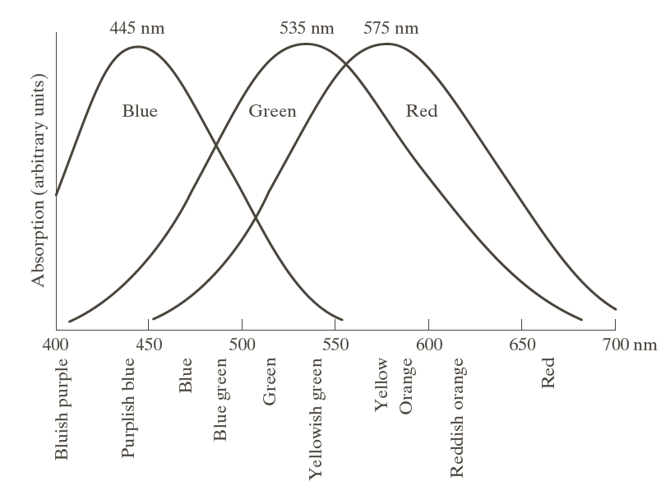
6.1 Color Fundamentals
Relative Absorption of R/G/B cones
Figure 6.3 Absorption of light by the red, green, and blue cones in the human eye as an function of wavelength.

Slide 18
6.1 Color Fundamentals
Absorption characteristic of eye and Primary colors:
Curves are experimental
Colors are seen as variable combination of primary colors (R-G-B)
With three specific primary colors (fixed wavelength) it is NOT possible to generate all spectrum colors.

Slide 19
6.1 Color Fundamentals
Secondary Colors
Addition of primary colors:
Magenta = Red + Blue
Cyan = Green + Blue
Yellow = Red + Green
Mixing three primary and secondary with its opposite primary produce white color.

Slide 20
6.1 Color Fundamentals
Primary colors of light and primary colors of pigments (colorant):
Primary color of pigments:
Subtract or absorbs a primary color of light and reflect the other two!
Primary colors of light are: R-G-B
Primary colors of light are: C-M-Y
Primary colors of light are: C-M-Y
Primary colors of light are: R-G-B

Slide 21
6.1 Color Fundamentals
Primary colors of light and primary colors of pigments (colorant):
Color of light:
R
G
B
Color of pigments:
absorb R
Cyan
absorb G
Magenta
absorb B
Yellow
Problem is application dependent:
R-G-B: Primary for Color TV.
C-M-Y: Primary for Color Printer.

Slide 22
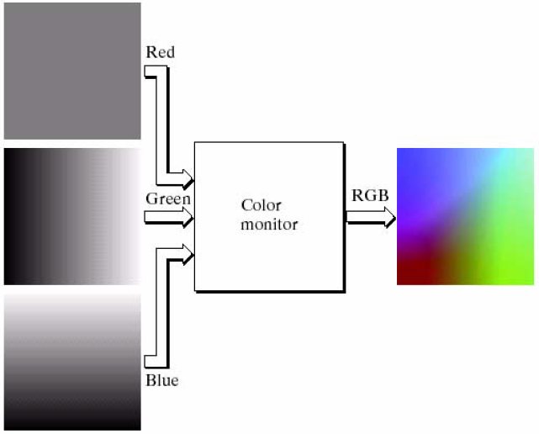
6.1 Color Fundamentals
Color TV

Slide 23
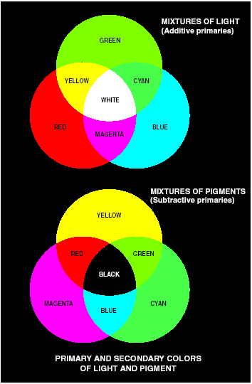
Light
Figure 6.4
Primary and secondary colors of light and pigments.
Pigments

Slide 24
6.1 Color Fundamentals
Characteristics of color
To distinguish a color from another
Hue, Saturation, and Brightness
Hue: Dominant color (wavelength) perceived by an observer. (Red, Orange, Yellow, and etc.)
Saturation: relative purity of color or the amount of white light mixed with a hue.
Pure colors (δ(λ – λ₀)) are fully saturated.
Pink is less saturated.
Brightness: chromatic notion of intensity.

Slide 25
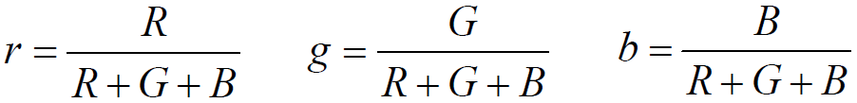
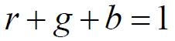
6.1 Color Fundamentals
Characteristics of color
Chromaticity: Hue + Saturation
Tri-stimulus:
The amounts of R/G/B needed to form any particular color (X, Y, and Z)
r, g, b
wavelength of light for that color

Slide 26
6.1 Color Fundamentals
Chromaticity Diagram (色度图)
Color composition as a function of red (x-axis) and green (y-axis).
Blue = 1 – Red – Green.
Not all color in chromaticity diagram are enclosed by a triangle!
With three single primary color we can NOT have all possible color!

Slide 27
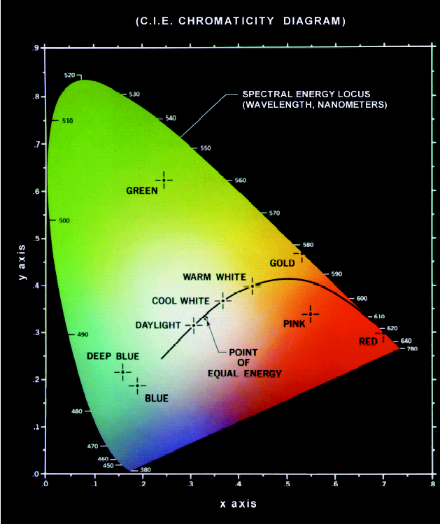
5. Color Mixing with various value of 2 colors
b = 1 – r – g
2. Mixed Color
6. Color Mixing with various value of 3 colors
1. Boundary are full saturated (Pure Color)
3. CIR White (1/3, 1/3, 1/3) - zero saturation
4. All shade of Pure color

Slide 28
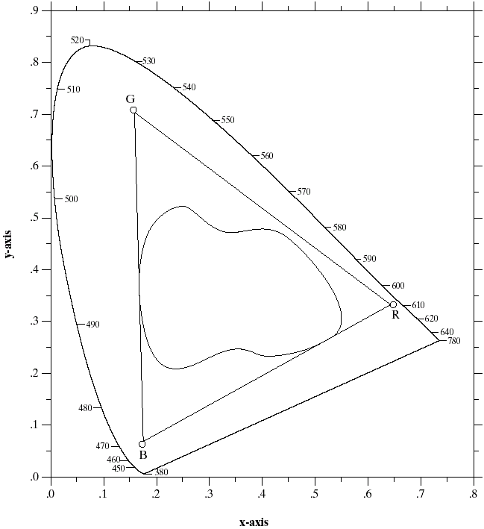
Figure 6.6 Typical color gamut of color monitors (triangle) and color printing devices (irregular region).
Chromaticity Diagram
Monitor colors
Printers Inks

Slide 29
6.2 Color Models
Color Model (Color Space, Color System)
Specify colors in a standard way
A coordinate system that each color is represented by a single point.
Most used models:
RGB model (Monitor/TV)
CYM model (3-color Printers)
CYMK model (4-color Printers)
HSI model (Color Image Processing and Description)

Slide 30
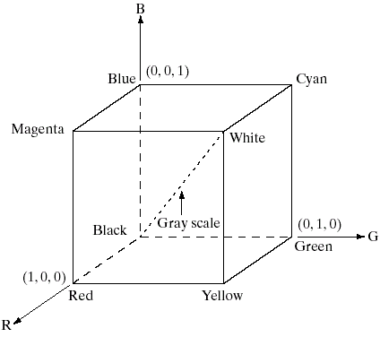
6.2.1 RGB Color Model
Three Primary Colors
Figure 6.7 Schematic of the RGB color cube. Points along the main diagonal have gray values, from black at the origin to white at point (1, 1, 1).

Slide 31
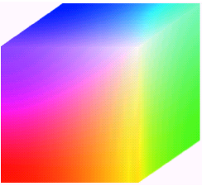
6.2.1 RGB Color Model
Pixel Depth: The number of bits used to represent each pixel in RGB space.
Full-color image: 24-bit RGB color image.
(R, G, B) = (8 bits, 8 bits, 8 bits)
Number of colors:
(2⁸)³ = 16,777,216
Figure 6.8 RGB 24-bit color cube.

Slide 32
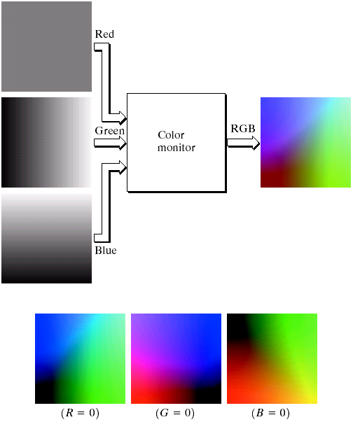
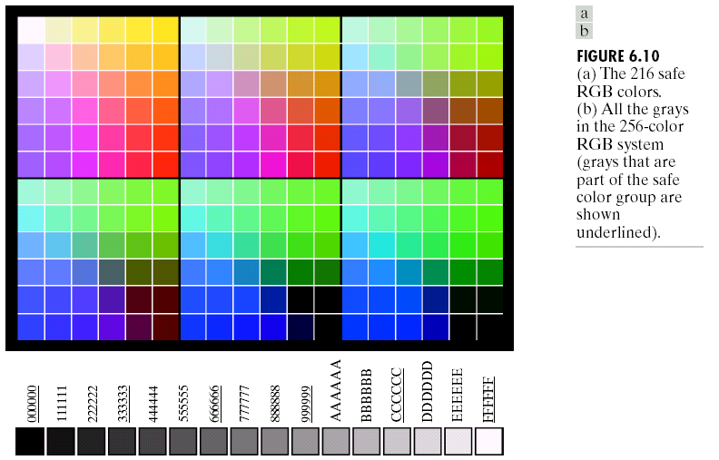
Color Image Generation
Figure 6.9
(a) Generating the RGB image of the cross-sectional color plane (127, G, B).
(b) The three hidden surface planes in the color cube of Fig. 6.8.
Color Image Acquisition
Filter-Sensor

Slide 33
6.2.1 RGB Color Model
Safe RGB Colors
Subset of colors is enough for some application
Safe RGB colors (safe Web colors, safe browser colors)
Only 6 levels of each primary colors are used.
6³ = 216
000000 = Black
000000 = White
000000 = Purest Red

Slide 34
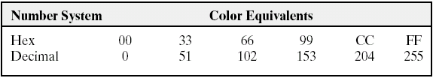
6.2.1 RGB Color Model
Safe RGB Model
Table 6.1 Valid values of each RGB component in a safe color.

Slide 35
Figure 6.10
(a) The 216 safe RGB colors.
(b) All the grays in the 256-color RGB system.
Grays that are part of the safe color group.

Slide 36
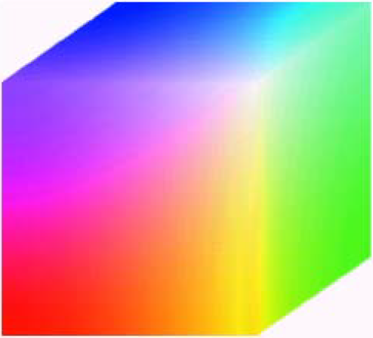
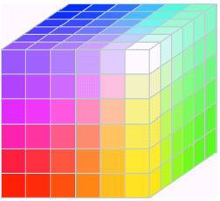
6.2.1 RGB Color Model
Safe RGB Colors
Full Color RGB
Safe RGB

Slide 37
6.2.2 CMY and CMYK Color Models
CMY: Secondary colors of light, or primary colors of pigments are used.
Used to generate hardcopy output (Printer and Copier).
Some facts:
Printer papers are white (reflect all colors)
Printers use ink (Transparent)
Cyan-Magenta-Yellow Pigments (ink) absorb Red-Green-Blue

Slide 38
6.2.2 CMY and CMYK Color Models
CMY and CMYK models
Printers: Overlapping layers of varying percentages of transparent cyan, magenta, and yellow inks.
Light is transmitted through the inks and reflects off the surface below them.
The percentages of CMY ink subtract inverse percentages of RGB from the reflected light so that we see a particular color.

Slide 39
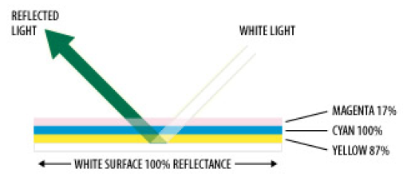
6.2.2 CMY and CMYK Color Models
CMY and CMYK models
White paper reflect 100% of incoming light.
CMY inks are 100, 17 and 87%
K (Black) is practical problem of C+M+Y≠Black (Muddy Brown). Add a fraction of Black color

Slide 40
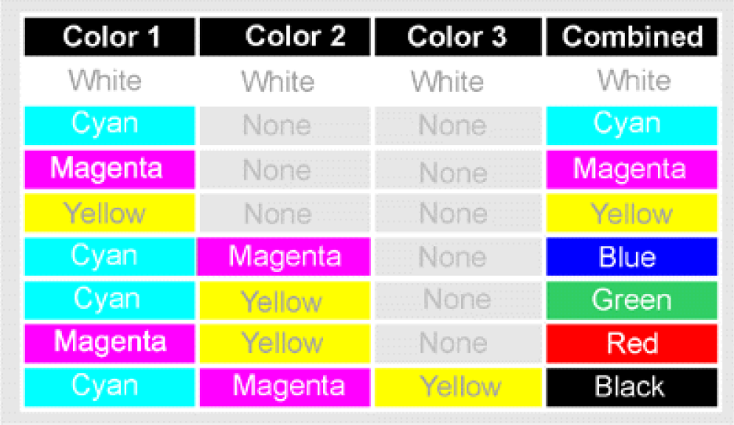
6.2.2 CMY and CMYK Color Models
CMY and CMYK models

Slide 41
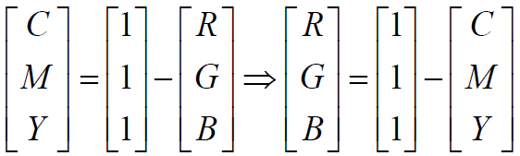
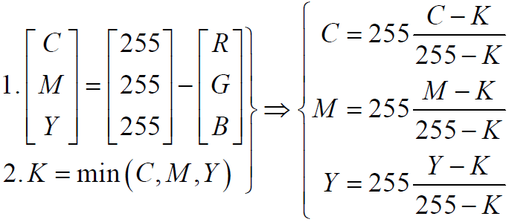
6.2.2 CMY and CMYK Color Models
CMY to RGB
RGB to CMYK

Slide 42
6.2.3 HSI Color Model
Human description of color is not RGB or CMYK
Human description of color is Hue, Saturation and Brightness:
Hue: color attribute
Saturation: purity of color
Brightness: achromatic notion of intensity

Slide 43
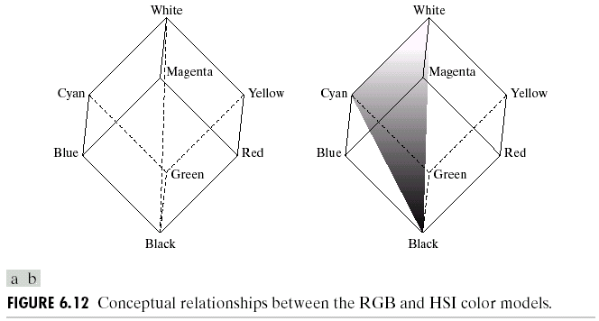
6.2.3 HSI Color Model
RGB to HSI conversion
Iso-Hue Triangle
Intensity Line
(Equal RGB value)
Intensity
Saturation
(Distance)
Figure 6.12 Conceptual relationships between the RGB and HSI color models.

Slide 44
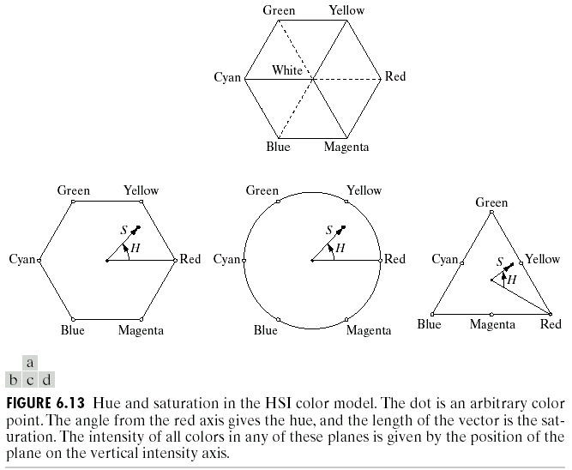
Different Geometrical Model is possible
Figure 6.13 Hue and saturation in the HSI color model.

Slide 46
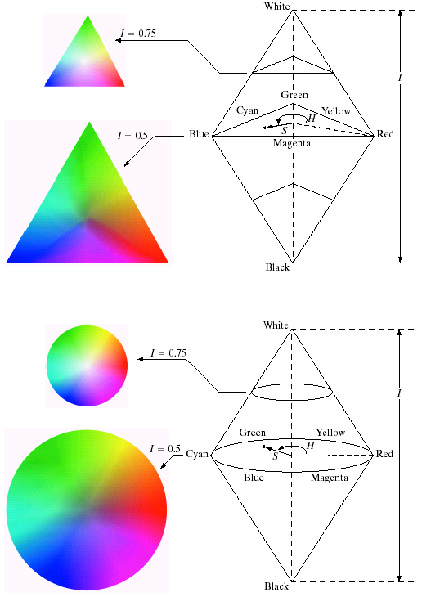
Figure 6.14 (a) The HSI color model based on triangular color planes.

Slide 47
Figure 6.14 (b) The HSI color model based on circular color planes.

Slide 48
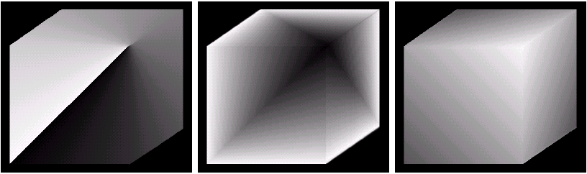
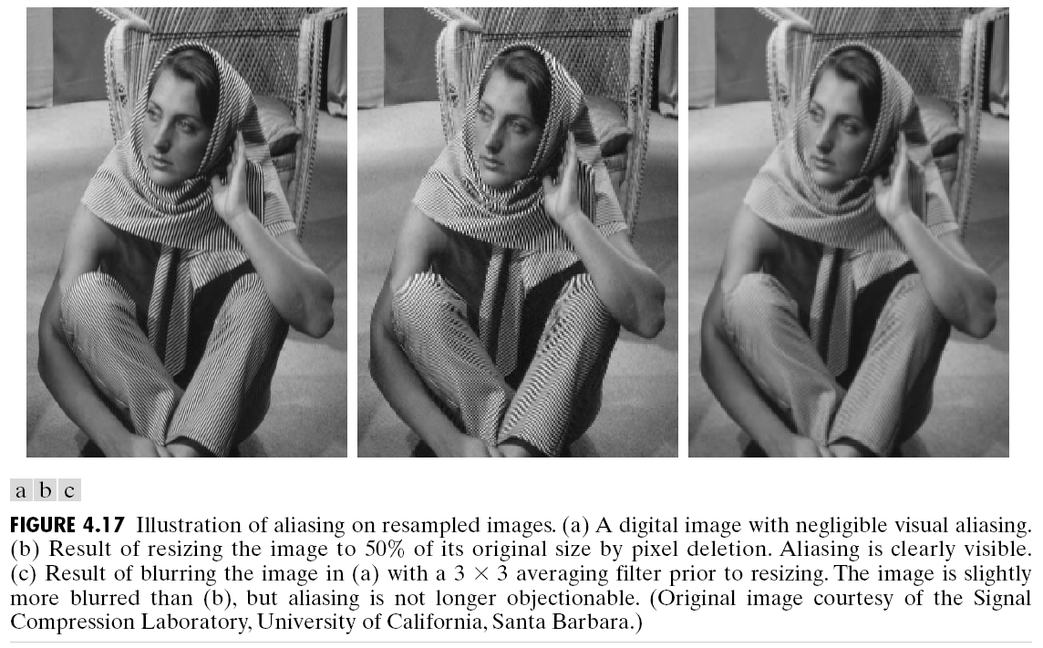
6.2.3 HSI Color Model
Split Channel
Figure 6.15 HSI components of the image in Fig. 6.8.
(a) Hue, (b) saturation, and (c) intensity images.

Slide 49
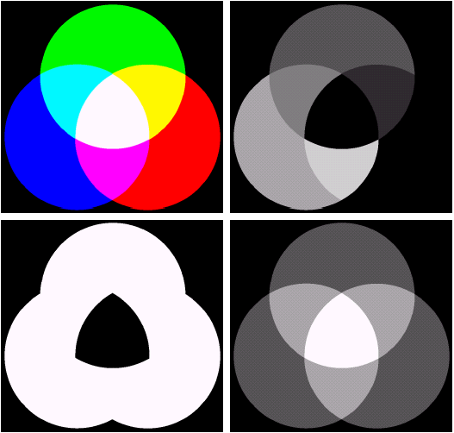
Channel Split
Figure 6.16
(a) RGB image and the components of its corresponding HSI image:
(b) hue,
(c) saturation,
(d) intensity.

Slide 50
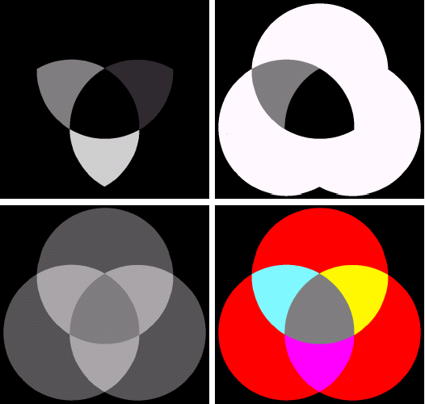
Modifying Channel
Figure 6.17
(a)-(c) Modified HSI component images.
(d) Resulting RGB image.

Slide 51
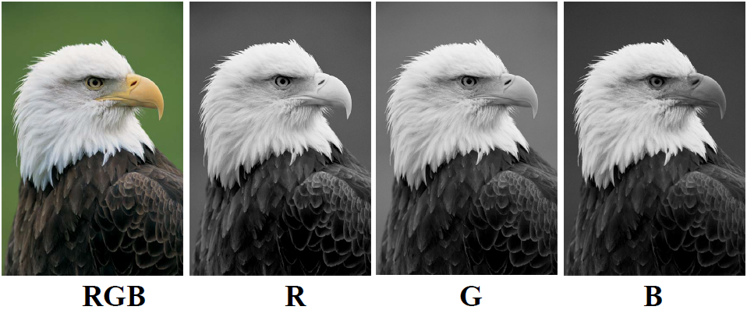
6.2.3 HSI Color Model
Split Channel (RGB Model)

Slide 52
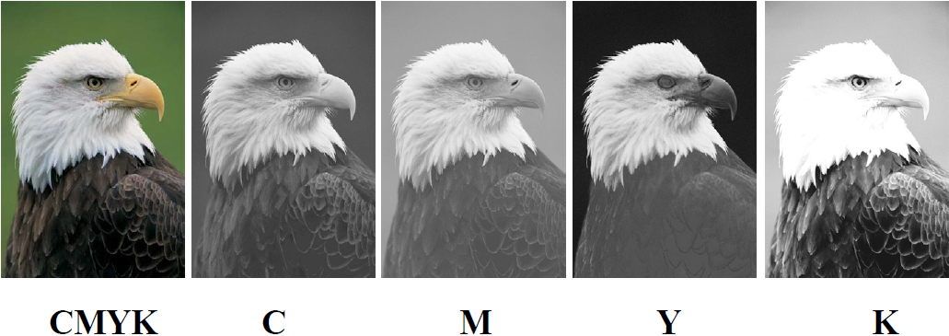
6.2.3 HSI Color Model
Split Channel (CMYK Model)

Slide 53
6.3 Pseudo-color Image Processing
Assign colors to gray values based on a specified criterion
For human visualization and interpretation of gray-scale events
Methods:
Intensity slicing
Gray level to color transformations

Slide 54
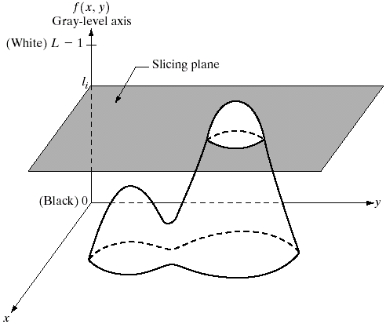
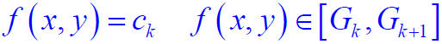
6.3.1 Intensity Slicing
Gray Level Slicing
Color 1
Figure 6.18
Geometric interpretation of the intensity-slicing technique.
Color 2

Slide 55
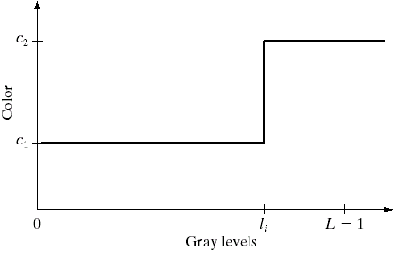
6.3.1 Intensity Slicing
Gray Level Slicing (Two Levels)
Figure 6.19
An alternative representation of the intensity-slicing technique.

Slide 56
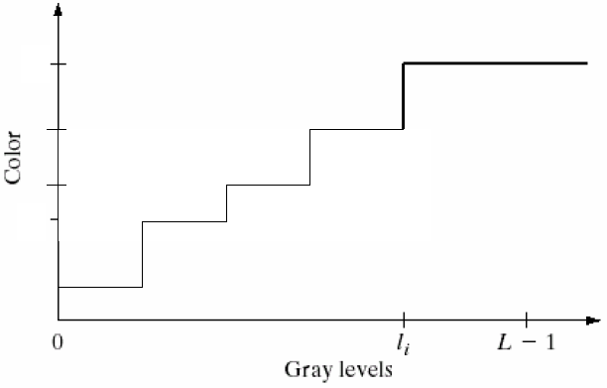
6.3.1 Intensity Slicing
Gray Level Slicing (More Levels)

Slide 57
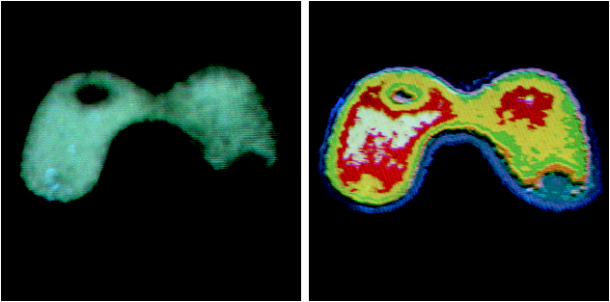
Example (Nuclear Imaging) with 8 levels
Figure 6.20
(a) Monochrome image of the Picker Thyroid Phantom.
(b) Result of density slicing into eight color.

Slide 58
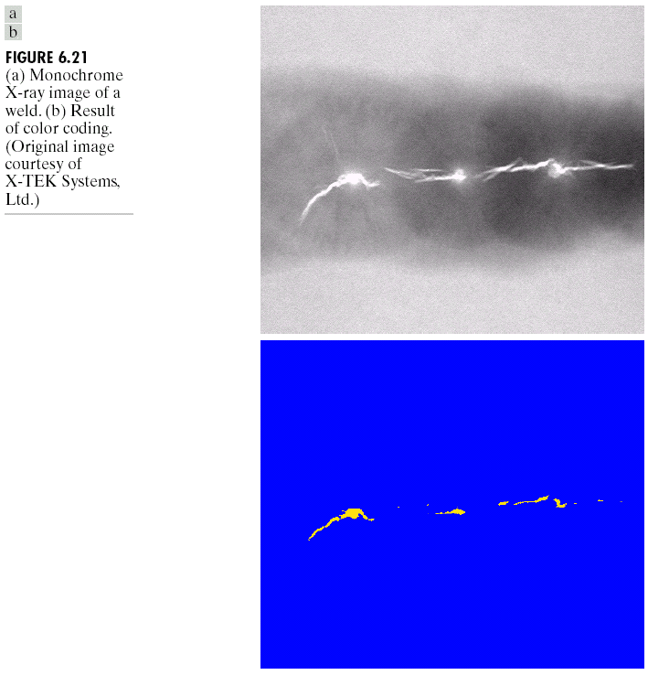
Industrial Application: Welding (焊接)
Figure 6.21
(a) Monochrome X-ray image of a weld.
(b) Result of color coding.

Slide 59
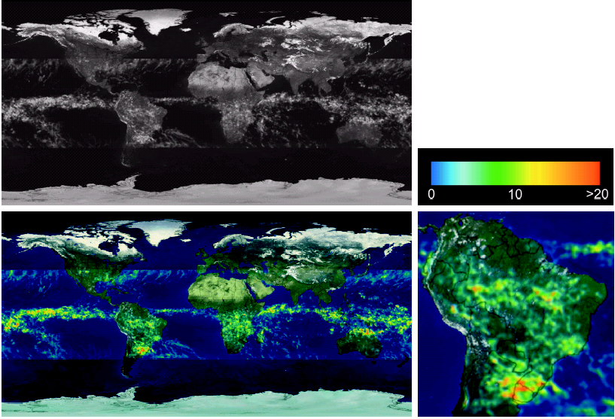
Figure 6.22
(a) Gray-scale image in which intensity corresponds to average monthly rainfall. (b) Colors assigned to intensity values.
(c) Color-coded image. (d) Zoom of the South America region.

Slide 60
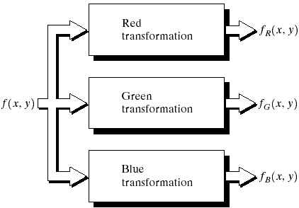
6.3.2 Intensity to Color Transformations
Gray Level to Color Transform
Figure 6.23
Functional block diagram for pseudo-color image processing.

Slide 61
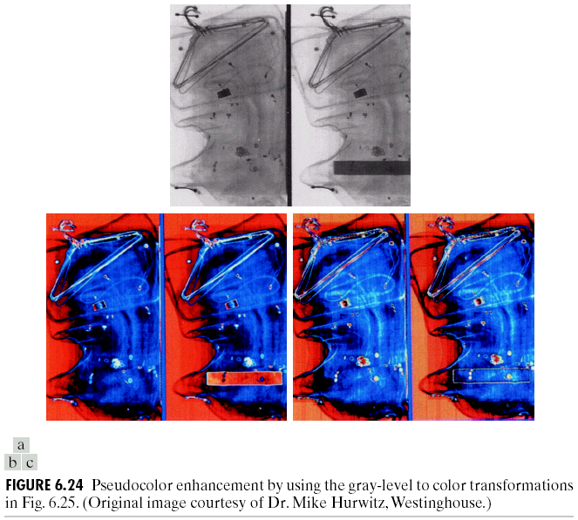
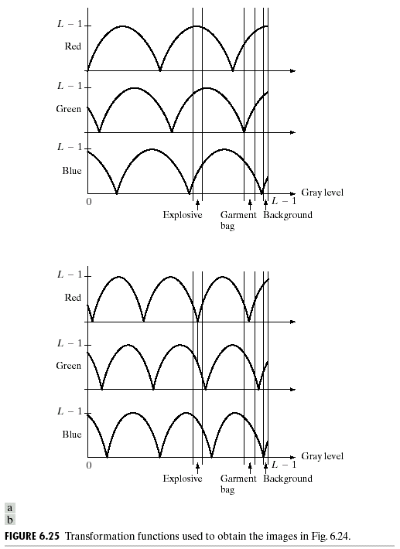
Pseudo-color enhancement by using the gray-level to color transformations.
Transformation function

Slide 62
Pseudo-color enhancement by using the gray-level to color transformations.
Transformation function

Slide 63
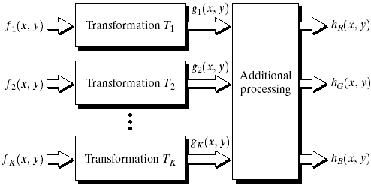
6.3.2 Intensity to Color Transformations
Combine several monochrome images
multi-spectral images (Remote Sensing/Medical)
Figure 6.26 A pseudo-color coding approach used when several monochrome images are available.

Slide 64
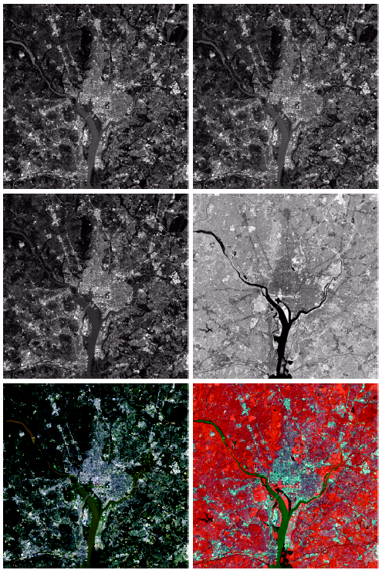
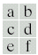
Figure 6.27
(a)-(d) Images in bands 1-4.
(e) Color composite image obtained by treating (a), (b), and (c) as the red, green, blue components of an RGB image.
(f) Image obtained in the same manner, but using in the red channel the near-infrared image in (d).

Slide 65
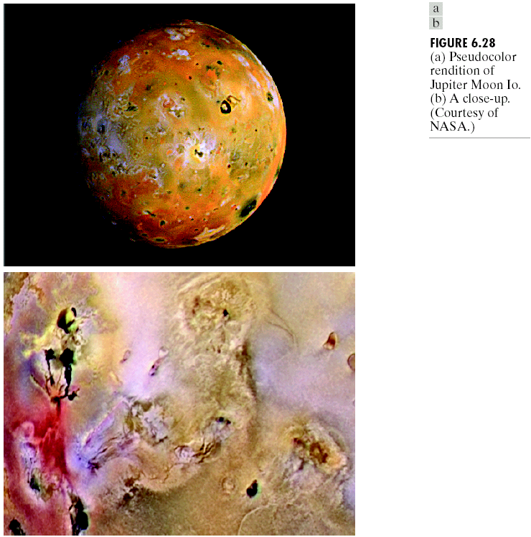
6.3.2 Intensity to Color Transformations
Using Knowledge
Figure 6.28
(a) Pseudocolor rendition of Jupiter Moon Io.
(b) A close-up.

Slide 66
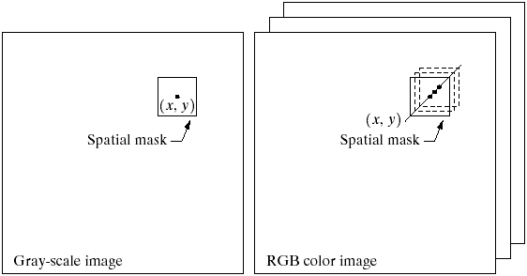
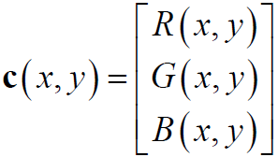
6.4 Full-Color Image Processing
Process each color components individually
Process color vector directly
Figure 6.29 Spatial masks for gray-scale and RGB color images.

Slide 67




6.5 Color Transformations
Gray Level Transform:
Color Image Transform:
n = 3 for RGB/HSI/CMY
n = 4 for CMYK
Intensity Magnification:
HSI:
RGB:
CMY:

Slide 68

Figure 6.30
A full-color image and its various color-space components.

Slide 69

Figure 6.31
Adjusting the intensity of an image using color transformations. (a) Original image.
(b) Result of decreasing its intensity by 30%. (c)-(e) The required RGB, CMY, and HSI transformation function.

Slide 70

6.5.2 Color Complements
Analogy of Gray-Level Negative
Color Complement: Hue directly opposite one another on color circle.
Figure 6.32
Complements on the color circle.

Slide 71

Figure 6.33
Color complement transformations.
Original image.
(b) Complement transformation functions.
(c) Complement of (a) based on the RGB mapping functions.
(d) An approximation of the RGB complement using HSI transformations.

Slide 72

6.5.3 Color Slicing
Highlight a specific range of colors.
Set non desired color to gray level.

Slide 73

Figure 6.34 Color slicing transformations that detect (a) reds within an RGB cube of width W = 0.2549 centered at (0.6863, 0.1608, 0.1922), and (b) reds within an RGB sphere of radius 0.1765 centered at the same point.

Slide 74

Tone Correction:
All channels modified simultaneously to correct brightness and contrast.
Flat
Figure 6.35
Tonal corrections for flat, light (high key), and dark (low key) color images. Adjusting the red, green, and blue components equally does not always alter the image hues significantly.
Light
Dark

Slide 75

Color Correction:
Each channel modified individually to correct color imperfection.
Figure 6.36
Color balancing corrections for CMYK color images.

Slide 76
6.5.4 Tone and Color Corrections
Histogram Processing
Histogram Equalization may NOT apply independently!
Logical approach:
Uniform Intensity
Hue unchanged
Saturation may be changed or not!

Slide 77

Figure 6.37
Histogram equalization (followed by saturation adjustment) in the HSI color space.

Slide 78

6.6 Smoothing and Sharpening
Color Image Smoothing
Like as Gray Level Images!

Slide 79

6.6.1 Color Image Smoothing
Color Image
R-Channel
G-Channel
B-Channel

Slide 80

6.6.1 Color Image Smoothing
H-Channel
S-Channel
I-Channel

Slide 81

6.6.1 Color Image Smoothing
RGB-Smoothing
I-Smoothing
Difference

Slide 82

6.6 Smoothing and Sharpening
Color Image Sharpening

Slide 83

6.6.2 Color Image Sharpening
RGB-Sharpening
I-Sharpening
Difference

Slide 84
6.7 Image Segmentation Based on Color
Color Image Segmentation
Will be discussed later!

Slide 85

6.7.1 Segmentation in HSI Color Space
Figure 6.42 Image segmentation in HSI space.
(a) Original. (b) Hue.
(c) Saturation. (d) Intensity. (e) Binary saturation mask (black = 0).
(f) Product of (b) and (c). (g) Histogram of (f).
(h) Segmentation of red components in (a).

Slide 86

6.7.2 Segmentation in RGB Vector Space
Figure 6.43 Three approaches for enclosing data regions for RGB vector segmentation.

Slide 87

Figure 6.44 Segmentation in RGB space.
Original image with colors of interest shown enclosed by a rectangle.
Result of segmentation in RGB vector space.

Slide 88
6.7.3 Color Edge Detection
Color Image Edge Detection
Previous Operator is not defined for vector space!
Problem is more complicated!

Slide 89

6.7.3 Color Edge Detection
Figure 6.45 (a)-(c) R, G, and B component images and (d) resulting RGB color image. (f)-(g) R, G, and B component images and (h) resulting RGB color image.
One change result two changes

Slide 90

6.7.3 Color Edge Detection
New Gradients vectors:
r, g, and b: unit vectors in R, G, and B axes.

Slide 91

6.7.3 Color Edge Detection
Direction of Maximum rate of changes c(x, y) is:

Slide 92

Figure 6.46
(a) RGB image. (b) Gradients computed in RGB color vector space.
(c) Gradients computed on a per-image basis and then added. (d) Difference between (b) and (c).

Slide 93

6.7.3 Color Edge Detection
R-Grad
G-Grad
B-Grad

Slide 94

6.8 Noise in Color Images
Corrupt R-G-B channel with Gaussian
Figure 6.48
(a)-(c) Red, green, and blue component images corrupted by additive Gaussian noise of mean 0 and variance 800.
(d) Resulting RGB image.

Slide 95
6.8 Noise in Color Images
H-Channel
S-Channel
I-Channel
Original

Slide 96

6.8 Noise in Color Images
H-Channel
S-Channel
I-Channel
Noisy

Slide 97

6.8 Noise in Color Images
Only G-Channel corrupted
All HSI channel affected

Slide 98
6.9 Color Image Compression
Color Image Compression
Will be discussed later

Slide 99

6.9 Color Image Compression
Figure 6.51 Color image compression.
(a) Original RGB image. (b) Result of compressing and decompressing the image in (a).

Slide 100
“智能视觉理解实验室”
Feel free to subscribe ☺

Slide 101
Thank you!

